Slide 1



The 2014 Condition of College and Career Readiness of Hispanic Students
Juan M. Garcia
Assistant Vice President – Client Relations
juan.garcia@act.org

Slide 2
Agenda
- About ACT
- Findings of 2014 report – National
- Trends of Hispanic students
- First Generation Students report
- Resources available
- Q&A

Slide 3
Our Mission
Helping people achieve education and workplace success
Our Values
Excellence in all aspects of our work
Mutual respect, fairness, and visionary leadership
Diversity in people and ideas
Individual growth and development
Courteous, responsive, ethical relations with clients and colleagues
Conscientious citizenship and constructive engagement in civic life
Partnerships with other organizations

Slide 4

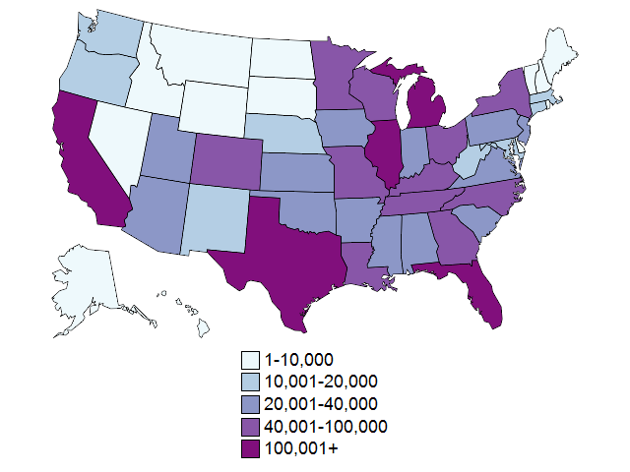
Number of ACT-Tested High School Graduates, 2014

Slide 5
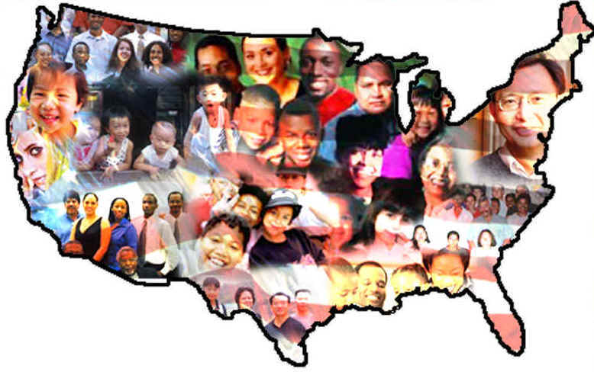
The 2014 Condition of College and Career Readiness of Hispanic Students
In 2014 281,216 Hispanic students, graduating from High School took The ACT.
Between 2009 and 2013, the number of Hispanic students taking The ACT grew 94%
Are our students meeting the college and
career readiness benchmarks?

Slide 6
What is meant by College Readiness
ACT defines college readiness …
  As the level of achievement a student needs to be ready to enroll and succeed (without remediation) in credit-bearing, first-year postsecondary courses
    Academic readiness in English, Reading, Math, & Science
    Other domains not included … at this time (e.g., behaviors, goals)
    Relevant for 2-year and 4-year postsecondary institutions

Slide 7
What is meant by College Readiness
ACT College Readiness Benchmarks
  Are scores on the ACT subject-area tests that represent a high probability of success in corresponding credit-bearing first-year college courses
    Based on 230K postsecondary students at 200+ PSEs
    Typical set of expectations – representative of 2- & 4-year PSEs nationally

Slide 8

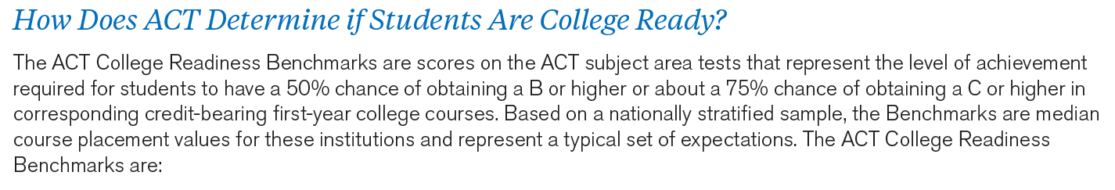
College Readiness Benchmarks
Test | College Course |  |  | ACT Plan | The ACT
 |  | 8th Grade | 9th Grade
English | English Composition | 13 | 14 | 15 | 18
Math | College Algebra | 17 | 18 | 19 | 22
Reading | Social Sciences | 16 | 17 | 18 | 22
Science | Biology | 18 | 19 | 20 | 23
ACT Explore
8

Slide 9
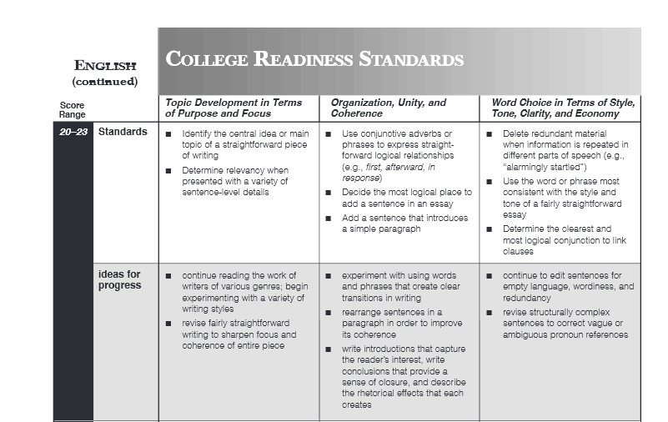

Statements that describe what students are
likely to know and be able to do…
And statements that provide suggestions to
progress to a higher level of achievement
www.act.org/standard

Slide 10
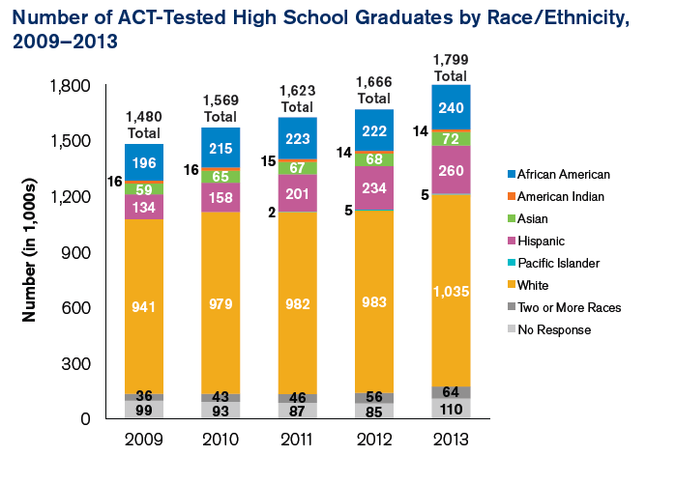
Number of 2009-2013 ACT-Tested High School Graduates by Race/Ethnicity
Notes:
About 319,000 more high school graduates completed the ACT in 2013 than in 2009, an increase of about 22%. In 2013, about 58% of all ACT tested graduates were White, 13% were African American, 14% were Hispanic, 4% were Asian, 4% were of Two or More Races, 1 % were American Indian, less than 1% were Pacific Islander (about 5,000), and 6% were No Response. From 2009 to 2013, the number of ACT-tested high school graduates increased from 1.480 million to 1.799 million students. Substantial numerical increases occurred from Hispanic students (increase of about 126,000), White students (94,000), African American students (43,000) and students of two or more races (29,000). Proportionally, the largest increases were by Hispanic students (about 94%) and students of two or more races (80%).

Slide 11
Percent of ACT-Tested High School Graduates by Race/Ethnicity and Educational Aspirations, 2013.
Notes:
About 87% of all 2013 ACT tested high school graduates aspired to attain at least a 2-year postsecondary degree, regardless of race/ethnicity. About 82% of Asian graduates aspired to earn at least a bachelor’s degree, with 53% aspiring to continue their formal education beyond a 4 year degree. American Indian graduates (28%) were the least likely to aspire to a graduate or professional degree;33%-36% of African American, Hispanic, Pacific Islander, or White graduates aspired to a graduate or professional degree.

Slide 12
Percent of ACT-Tested High School Graduates Meeting ACT College Readiness Benchmarks by Race/Ethnicity, 2013
Notes:
Just over 4 in 10 (43%) Asian graduates met all four ACT College Readiness Benchmarks in 2013, a higher rate than that of graduates from all other racial/ethnic groups. African American graduates were least likely to meet the Benchmarks-5% met all four. Students from most racial/ethnic groups were most likely to meet the English Benchmark and least likely to meet the Science Benchmarks. In three of the four subject areas, benchmarks were met by 50% nor more of Asian and White students, while one was met by 50 % or mor of Pacific Islandern students. None of the Benchmarks were met by 50% or more African American, American Indian, or Hispanic students.

Slide 13
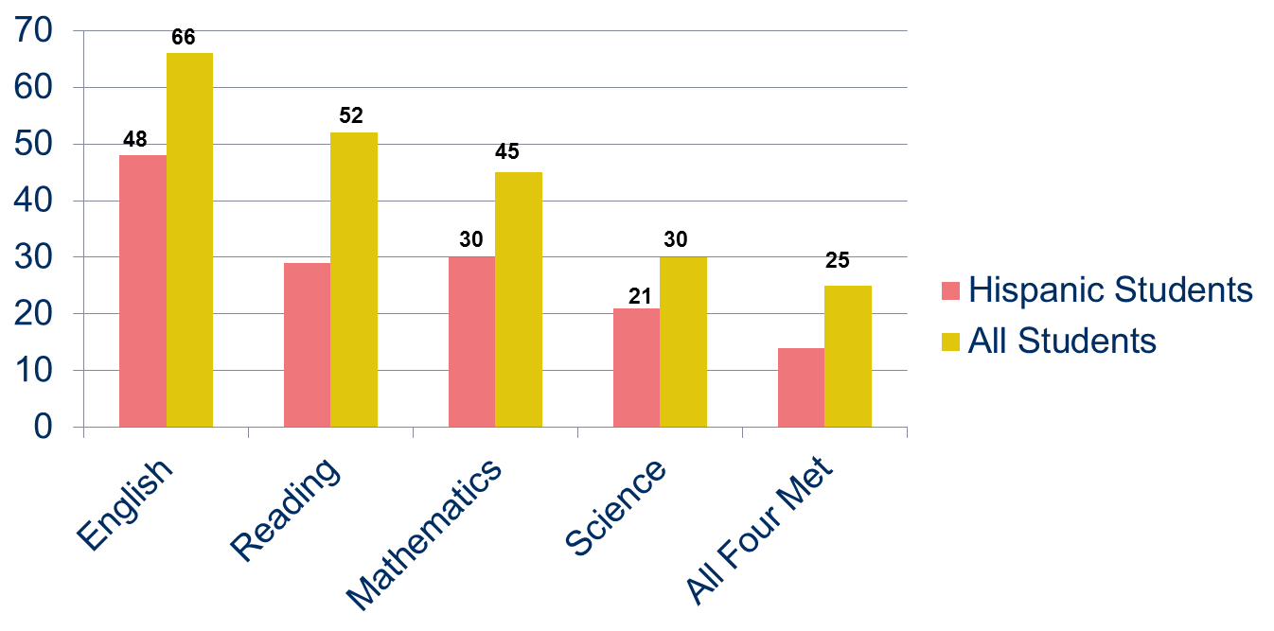
Percent of 2013 ACT-Tested Hispanic High School Graduates Meeting College Readiness Benchmark by Benchmarks by Subject
Percent
29
14

Slide 14

Percent of 2013 ACT-Tested Hispanic High School Graduates by Number of ACT College Readiness Benchmarks Attained
114,400
36,400

Slide 15
Percent of 2013 ACT-Tested High School Graduates Meeting Three or More Benchmarks by Race/Ethnicity
Percent
19
10

Slide 16
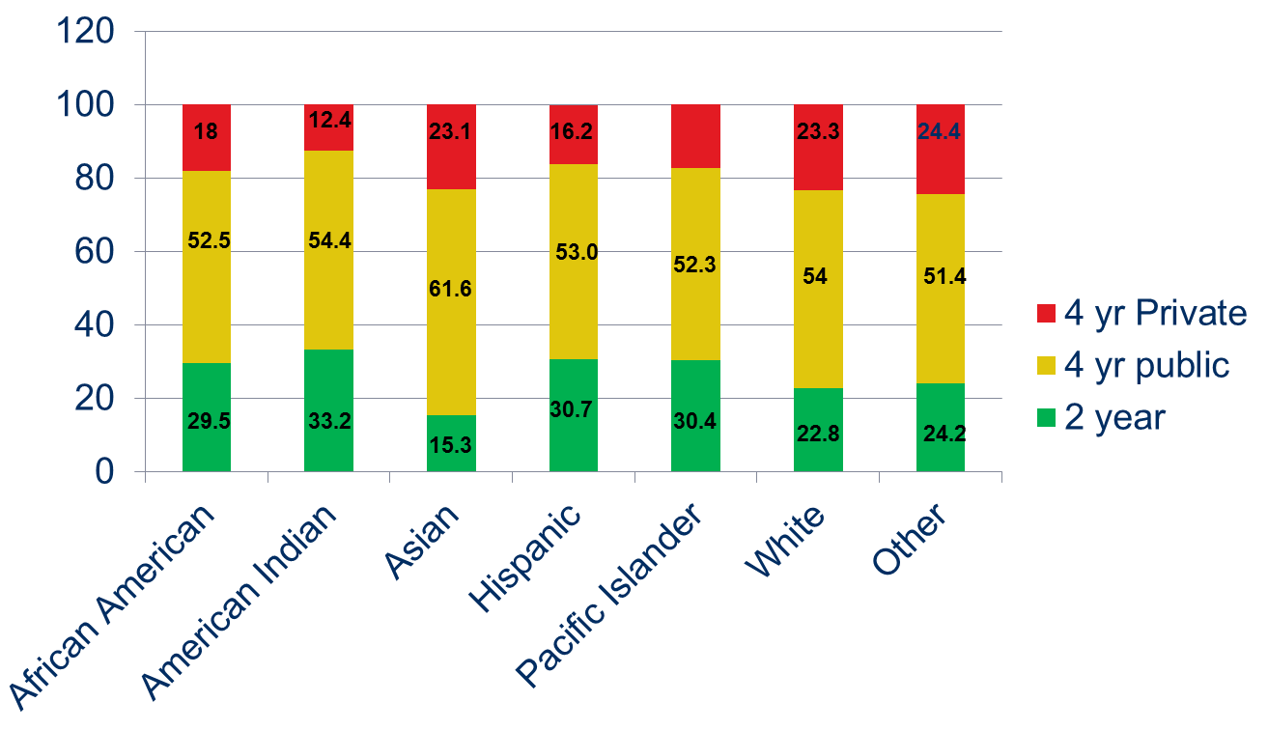
Enrollment-Percent Enrolled in Different College Types
17.3
Percent

Slide 17
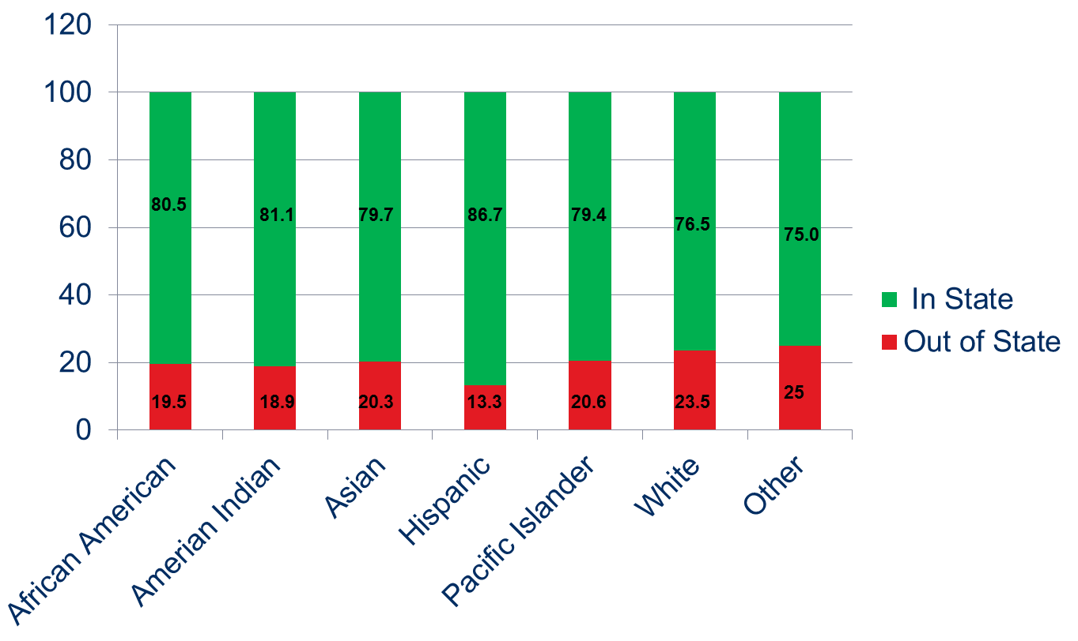
Enrollment-Percent Enrolled in Different College Types
Percent

Slide 18
Percent of 2012 ACT-Tested Graduates Immediately Enrolling into College the Fall Following High School Graduation by Number of ACT College Readiness Benchmarks Attained and Race/Ethnicity
Percent

Slide 19
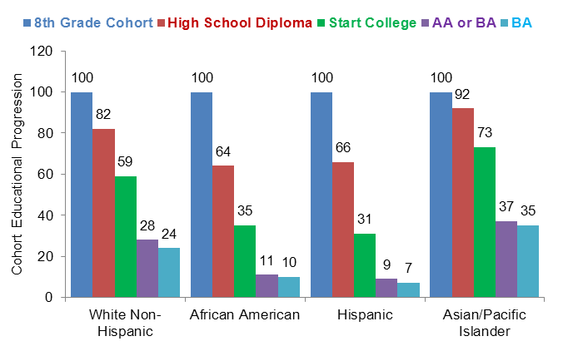
Educational progression of 2009 high school graduating class by race/ethnicity

Slide 20
About The Condition

Slide 21
College Readiness – Report Basics
First-generation students
  Within the report = parent(s) did not enroll in postsecondary education
  COE = parent(s) did not complete a B.A.
335,711 first-generation students (19%)
  1.8M overall
  census testing in about 11 states
  54% of 2013 high school grads
College Readiness Benchmark attainment

Slide 22
Educational Aspirations
94% of “first-generation” students aspire to earn postsecondary degrees

Slide 23
College Readiness Benchmark Attainment

Slide 24

CRB Attainment & Near Attainment

Slide 25
# of CRBs Attained
All Students
1st Generation

Slide 26

It is important to remember…
What we have learned together through this study is important for a greater understanding of first-generation students.
Yes, many such students face multiple challenges to their academic success.
And, yes, many are not as academically ready for college as they need to be.

Slide 27

It is important to remember…
Nearly 94% of ACT-tested first-generation
students aspired to earn some form of postsecondary degree.
Two out of three took ACT’s recommended core curriculum (four years of English and three years each of math, science, and social studies).
And 60% of 8th and 10th graders were on target to be academically prepared for college-level courses in at least one subject.

Slide 28


Additional Resources
Free online tool that helps
students answer the college
and career planning question:
“What do I want to do?”
Offers students the powerful,
personalized insights they
need to make smarter decisions about their next steps
after high school www.act.org/profile
28

Slide 29
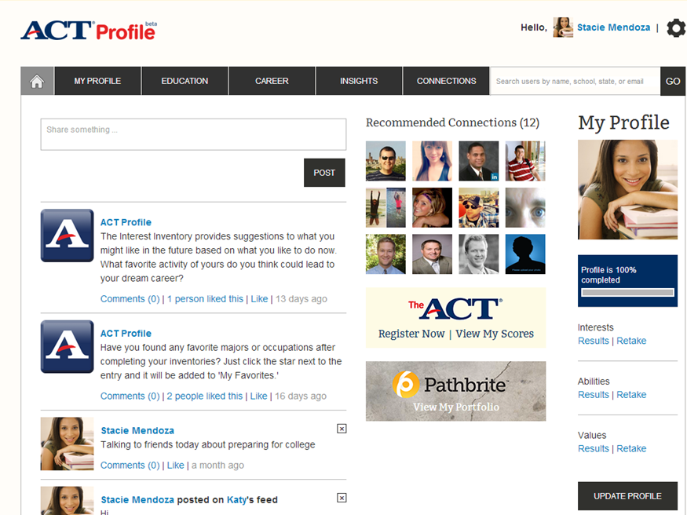
29

Slide 30
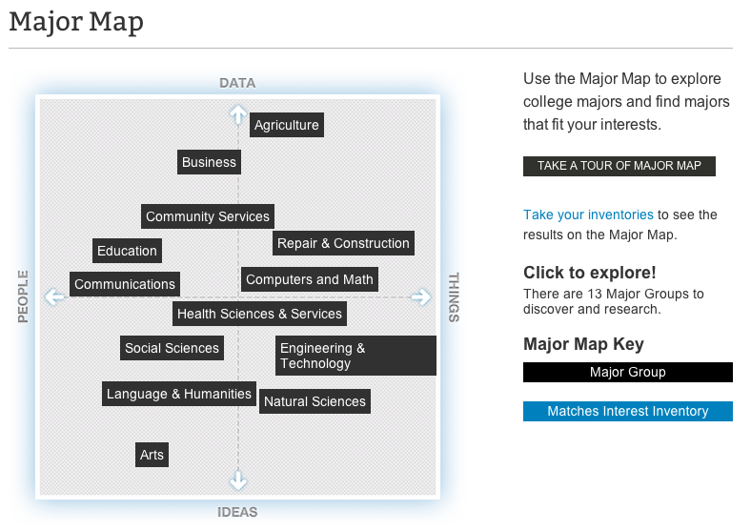
30
Notes:
The major map organizes many popular majors into 13 groups. The location of each major in a group is based n the interests of college students in that major.
Select a group to see the majors in that group. Then select a major to learn about topics of study, degrees, related occupations, and more.
Where are you on the map? Complete the interest inventor and see where your results place you on the map.

Slide 31
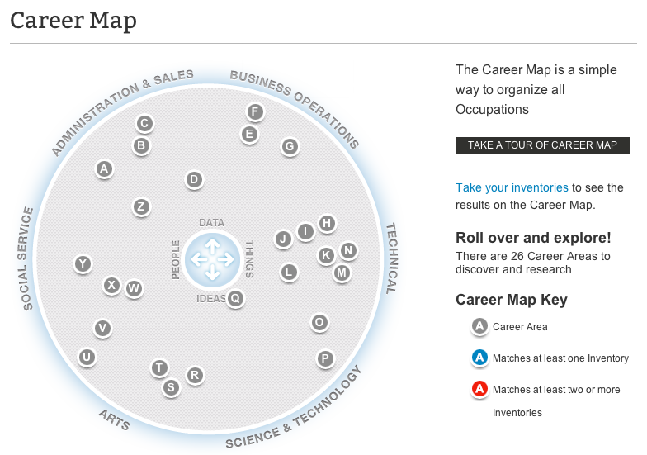
31
Notes:
Like any map, the Career Map provides a sense of direction. The map’s compass points are basic work tasks: working with data (facts, records), ideas (theories, insights), things (machines, materials), and people.
The map organizes hundreds of occupations into 26 Career Areas (groups of similar occupations). The map locates Career Areas according to their basic work tasks.
Where are you on the map? Complete the inventories and see where you interests, abilities, and values place you on the map.

Slide 32

ACT Social Media
ACT is active on Twitter, Facebook,
Google+, Pinterest, and LinkedIn
ACT’s Facebook and Twitter are the
two most popular platforms for students, parents, and educators:
  www.facebook.com/theacttest
  www.twitter.com/actstudent (@actstudent)
  “Question of the Day” allows students to put the solution into their own words
32

Slide 33
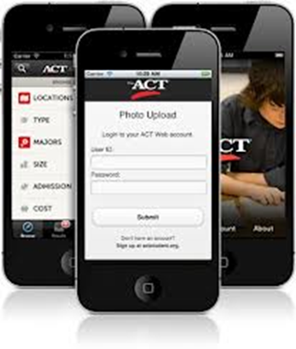



ACT Student Phone App
Search: ACT Student

Slide 34
Internet Resources
www.act.org/student
www.act.org/profile
www.collegeweeklive.com
www.scholarships.uncf.org
www.maldef.org
www.Collegenet.com
www.finaid.org
www.scholarships.com
www.fastweb.com
www.todaysgibill.org
www.hsf.net

Slide 35

Research Resources
1) Research-www.act.org/research
2) Condition of College and Career Readiness-Is ACT’s annual report on the college readiness of the most recent high school graduation class.
3) College Choice Report-Part 1-Preference and Prospect-The self-reported college preferences and ACT Educational Opportunity Service (EOS) participation rates of the ACT-tested high school graduating class of 2012
4) College Choice Report-Part 2- Enrollment Patterns- The College enrollment of the ACT tested high School graduation class of 2012, focusing on student mobility, the extent to which students’ college choices match their preferences, and the enrollment rates of students selected through EOS.
5) Reality of College and Career Readiness-Traces the college enrollment, retention, re-enrollment, and migration patterns of the 2011 ACT tested high school graduates.

Slide 36

Questions

Slide 37



Thank You!
319-333-4861
Juan.garcia@act.org

